Slide 1
Lesson 4
Notes:
13:00–13:15 recap of Lessons 1–3 13:15–14:00 short theoretical block 14:00–14:20 reporting standards + presentation instructions 14:20–14:35 break 14:35–16:25 student presentations 16:25–16:50 collective feedback/discussion 16:50–17:00 wrap-up

Slide 2
Linking trajectories to outcomes and presenting results
Raw longitudinal data
Sequences
Distances
Trajectory types
Interpretation and communication
We have created trajectory types. What do they help us understand?
Notes:
Today is less about learning a new algorithm. It is about deciding how sequence-analysis results enter a broader research design and how we present them without claiming more than the analysis supports

Slide 3
Where we are now
build → describe → compare → cluster → interpret
Lesson 1: build and describe
Lesson 2: distances and OM
Lesson 3: clustering and typologies
Lesson 4: interpretation, mini-projects, presentations
Notes:
The quality of the final interpretation depends on every earlier decision.

Slide 4
Recap: what did we construct in Lessons 1-3?
Object 1 – A sequence definition
population;
time axis;
time unit;
state alphabet.
Object 2 – Descriptive outputs
index plots;
state distribution plots;
time in states;
transitions and complexity.
Object 3 – A concept of similarity
distance measure;
substitution costs;
indel costs.
Object 4 – A typology
clustering method;
number of clusters;
cluster labels.
Notes:
The cluster variable is not a variable that was originally present in the data. It is the result of this entire chain of decisions.

Slide 5
Today’s question: what can we do with trajectory types?
Trajectory types
Explain membership
Describe social patterns
Predict later outcomes
Three questions
Who follows each trajectory?
Are trajectories associated with later outcomes?
What features of trajectories matter most?
Notes:
A trajectory type can be the result to explain, an explanatory variable, or simply a descriptive summary

Slide 6
Using trajectory types in analysis

Slide 7
Trajectory types as descriptive summaries
Trajectory type | Share
Stable employment | 46%
Studies → employment | 24%
Early joblessness → employment | 18%
Continuing instability | 12%
Example
Before modelling anything, describe how common the trajectory types are and who is found in them.
Trajectory | Women | Men
Stable employment | 42% | 50%
Studies → employment | 27% | 21%
Early joblessness → employment | 18% | 18%
Continuing instability | 13% | 11%
Notes:
A descriptive comparison can already answer an important research question. Regression is not automatically necessary.

Slide 8
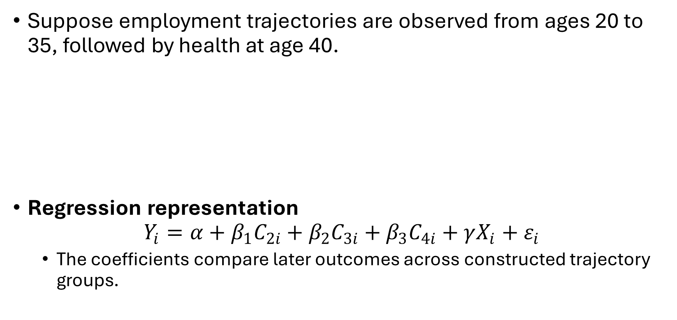
Trajectory types as explanatory variables
Suppose employment trajectories are observed from ages 20 to 35, followed by health at age 40.
Regression representation
$$Y_{i}=α+β_{1}C_{2i}+β_{2}C_{3i}+β_{3}C_{4i}+γX_{i}+ε_{i}$$
The coefficients compare later outcomes across constructed trajectory groups.
Employment trajectory | Mean health score at 40
Stable employment | 8.1
Studies → employment | 8.0
Early joblessness → employment | 7.4
Continuing instability | 6.8
Notes:
Explain simply:
$Y$: later outcome;
$C$: cluster membership;
stable employment is the reference;
$X$: earlier covariates.
Vanhoutte and colleagues note that trajectory classifications can be used as independent variables, for example by relating employment-history clusters to later health. They also caution that this does not automatically establish causality.

Slide 9
Trajectory types as outcomes to explain
Childhood socioeconomic position
Education and early resources
Employment trajectory type, ages 20-35
Question, e.g.:
Which earlier characteristics are associated with entering different employment trajectories?
Simple analytical options
Cross-tabulations
Multinomial logistic regression
Binary contrasts
Predicted probabilities.
Mind your formulation!
Notes:
Important wording
Prefer:
“Lower parental education was associated with a higher probability of following the unstable trajectory.”
Avoid:
“Lower parental education caused the unstable trajectory.”

Slide 10
Trajectory types aand later outcomes: examples
Work-family trajectories and health
Lacey et al. (2015) examined work-family life courses and markers of stress and inflammation in midlife.
Employment histories and quality of life
Wahrendorf (2015) studied how earlier employment histories were associated with quality of life at older ages.
Work and family-care histories
Benson et al. (2017) examined whether work and family-care histories predicted health among older women.

Slide 11
Descriptive contrasts before regression
Example: Mean depressive-symptom score by trajectory
Cluster | N | % | Mean outcome | Mean transitions
Stable employment | 460 | 46 | 4.2 | 1.1
Studies → employment | 240 | 24 | 4.3 | 1.8
Early joblessness → employment | 180 | 18 | 5.5 | 2.3
Continuing instability | 120 | 12 | 7.1 | 6.4
Regression should explain or refine the descriptive pattern, and not replace it.
Notes:
Why start here?
identify small clusters;
see the magnitude of differences;
detect unexpected patterns;
avoid hiding results behind adjusted coefficients.

Slide 12
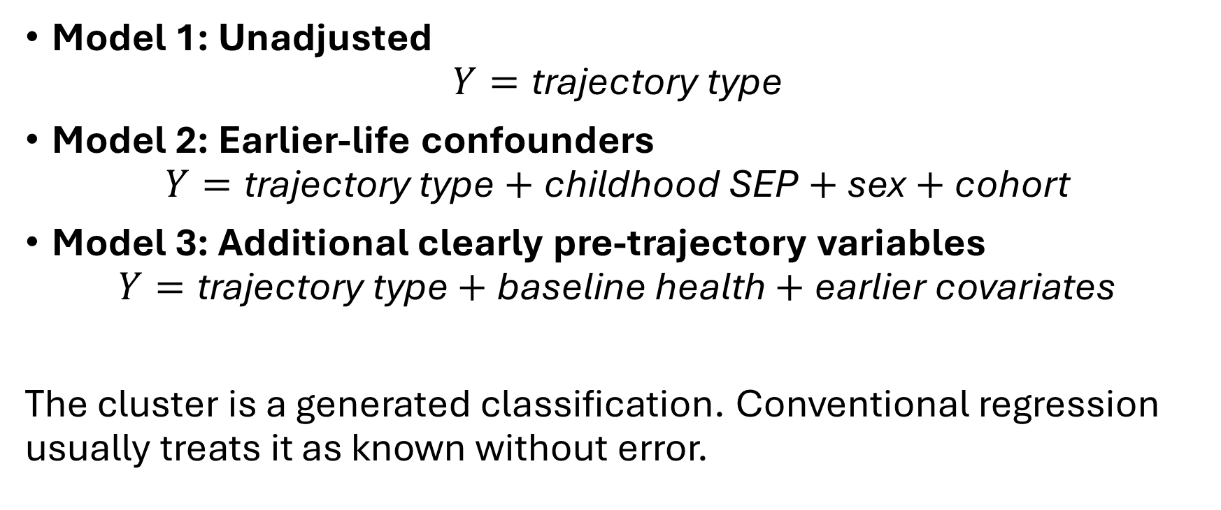
Regression with cluster membership
Model 1: Unadjusted
$$Y=\text{trajectory} \text{type}$$
Model 2: Earlier-life confounders
$$Y=\text{trajectory} \text{type}+\text{childhood} \text{SEP}+\text{sex}+\text{cohort}$$
Model 3: Additional clearly pre-trajectory variables
$$Y=\text{trajectory} \text{type}+\text{baseline} \text{health}+\text{earlier} \text{covariates}$$
The cluster is a generated classification. Conventional regression usually treats it as known without error.
Notes:
Interpretation example: ”Compared with the stable-employment cluster, the continuing-instability cluster had a 2.1-point higher symptom score.”
Cluster membership contains classification uncertainty, but standard second-stage models usually ignore it. This is another reason not to interpret small coefficient differences too strongly.

Slide 13

Regression with sequence indicators instead of clusters
A
B
C
Create numerical indicators:
Indicator | A | B | C
Time unemployed | 4 | 4 | 4
Number of transitions | 1 | 1 | 7
Unemployment begins early | No | Yes | Yes
Upward movement | No | Yes | Mixed
Regression example
$$Y_{i}=α+β_{1}{\text{Duration}}_{i}+β_{2}{\text{Transitions}}_{i}+β_{3}{\text{Early} \text{exposure}}_{i}+ε_{i}$$
Notes:
Main advantage: Indicators test a more specific hypothesis about which trajectory dimension matters.
Vanhoutte et al. describe numerical sequence indicators as a middle ground between highly detailed individual sequences and broad categorical typologies.

Slide 14
Clusters versus sequence measures: when to use which?
Use clusters when… | Use sequence indicators when…
The whole pathway matters | A specific mechanism is hypothesised
Several dimensions matter jointly | Duration, timing or instability can be isolated
You want an interpretable typology | You want a continuous measure
Patterns are difficult to summarise numerically | Cluster boundaries would be arbitrary
Visual communication is central | Parsimonious modelling is central
Or… Use both when appropriate
Example:
clusters for descriptive exploration;
indicators for hypothesis testing.
Notes:
Clusters answer “which pathway?” Indicators answer “which feature of the pathway?”

Slide 15
Interpretation problems and cautions

Slide 16
The danger of causal overinterpretation
Earlier health
Unstable employment trajectory
Poor health

Slide 17
The danger of causal overinterpretation
Childhood disadvantage
Unstable employment trajectory
Poor health
A relationship between a trajectory type and an outcome may reflect:
selection;
confounding;
reverse causation;
shared causes;
measurement and classification choices.
Notes:
Vanhoutte et al. explicitly note that using clusters in regression is reasonable but that strict causal attribution remains difficult.

Slide 18
Determinants, mediators and outcomes: clarify the time order
Childhood SEP
Employment trajectory
Health outcome
Age 15
20-35
Over 40
Determinant/confunder
Measured before the trajectory
Outcome
Measured after the complete trajectory window
Trajectory
Process of interest
Let’s add income at age 35:
Employment trajectory → Adult income → Health
Is adult income a confounder, a mediator, or part of the trajectory?
Notes:
Is adult income a confounder, a mediator, or part of the trajectory?
A variable’s role depends on when it is measured and where it belongs in the causal process.

Slide 19
Post-treatment bias: when adjustment goes wrong
Is employment instability between ages 20 and 35 associated with health at age 40?
If income at age 35 is partly produced by the employment trajectory, adjusting for it may block part of the pathway being studied.
Employment instability
Income at age 35
Health at age 40
Model | Interpretation
Without later income | Total association through all pathways
With later income | Association not operating through measured income
Notes:
“More adjusted” does not always mean “less biased.”
“The right adjustment set comes from the research question and time order, not from putting every available variable into the model.”

Slide 20
Conditioning on the future
20
35
Measure of employment trajectory
Outcome: Measure of mental health at age 28
If a cluster is constructed from the complete sequence between ages 20 and 35, it includes states occurring after depression was measured.
A cluster labelled “continuing instability” may partly be defined by instability occurring at ages 29–35; after the outcome.
The “predictor” contains future information.
Notes:
Better designs
measure the outcome after the sequence window;
shorten the sequence so it ends before the outcome;
use landmark or prefix sequences;
study trajectories as outcomes rather than predictors.
The complete sequence must temporally precede a later outcome if it is used as an exposure.

Slide 21
Clusters are constructed variables, not natural groups
States
Time unit
Distance measure
Cost settings
Clustering method
Number of clusters
Cluster variable
Three implications
Another reasonable specification may reassign some people.
Cluster boundaries may be gradual.
A label describes a dominant pattern, not every member.
Notes:
Treating cluster membership as perfectly measured may understate uncertainty.

Slide 22
What can we conclude and what can we not conclude?
Supported conclusions
trajectory patterns were observed in this population and period;
some patterns were more common than others;
clusters differed in their composition;
later outcomes varied across clusters;
results were more or less robust across specifications.
Unsupported without stronger design
one trajectory caused the later outcome;
clusters are natural types of people;
the same typology applies to every cohort or country;
cluster labels describe every person perfectly;
the chosen number of clusters is uniquely correct.
Notes:
We identified four descriptive trajectory types. Membership in these types was associated with later health, but the observational design does not establish causal effects.

Slide 23
Reporting sequence analysis

Slide 24
What to report in a sequence-analysis paper
Six reporting sections
research question and sequence rationale;
population and observation window;
state definition and time axis;
distance and clustering choices;
cluster interpretation and validation;
association models and limitations.
Notes:
Why sequences?
What was observed?
How were they constructed?
How were they compared?
How were types chosen?
What do the results mean?
Reporting should allow the reader to reconstruct the analytical logic.

Slide 25
Minimum reporting checklist
Sequence construction
population and inclusion criteria;
observation window;
time axis and unit;
alphabet and state-priority rules;
missing data and censoring.
Comparison and clustering
distance measure;
costs and normalisation;
clustering method;
number-of-cluster criteria;
sensitivity analyses.
Interpretation
cluster sizes;
plots and numerical summaries;
regression specification;
temporal order;
limits to causal interpretation.

Slide 26
How to present figures clearly
Figure 1. Overall trajectory structure
State distribution plot for the full sample.
Figure 2. Final typology
State distribution or index plots by cluster.
Figure 3. Substantive comparison
Predicted outcome or cluster probability with uncertainty intervals.
Design rules
Same state colours in every figure;
Readable labels;
Cluster sizes in headings;
Time axis clearly identified;
Avoid too many clusters per page;
Explain how sequences are sorted;
Show confidence intervals for modelled results.
Notes:
Never change the colour assigned to the same state between figures.

Slide 27
How to label clusters carefully
Do not put judgement in the title
Avoid ”successful”, ”traditional”, ”unsuccessful”…
A cluster containing:
might be labelled « Predominantly stable employment »
rather than: « Continuous employment »
because not every member is continuously employed.

Slide 28
From technical choices to substantive interpretation
Technical result | Substantive interpretation
High number of transitions | Frequent changes or instability
Long duration in unemployment | Accumulated labour-market exclusion
Education precedes employment | Delayed but ordered labour-market entry
Early versus late family transition | Different timing of family formation
Cluster-outcome coefficient | Outcome difference between constructed trajectory groups
Three-step interpretation process
Describe what is visible.
Connect it to the research question.
State what remains uncertain.
Notes:
“The continuing-instability cluster contained repeated movements between employment and unemployment and had the highest mean symptom score. This is consistent with an association between fragmented employment and poorer later mental health, although selection by earlier health cannot be excluded.”

Slide 29
Student presentations

Slide 30
Today’s mission for the lab
Today’s guided workflow
Load the common cluster solution
Add clusters to person-level data
Describe cluster size and composition
Compare later mental health by cluster
Run simple and adjusted regression models
Discuss time order and post-treatment adjustment
Compare clusters with numerical sequence indicators
Prepare mini-project presentation

Slide 31
New concepts
Now you should be able to explain:
Can trajectory types be outcomes?
Can trajectory types be explanatory variables?
Why start with descriptive contrasts?
What does a cluster coefficient compare?
Why is adjustment not automatically better?
What is post-treatment adjustment?
What is conditioning on future information?
When might sequence indicators be better than clusters?
What is one conclusion you can make from the analysis, and one conclusion you cannot make?

Slide 32
Mini-project
Today you complete Section 4 and Section 5 of your report
Substantive comparison
Interpretation
Sensitivity
Limitations
Before leaving today, write down:
My main finding is...
The strongest figure is...
One sensitivity result is...
One limitation is...
I will phrase my conclusion cautiously as...

Slide 33
Mini-project presentation format
Four slides
Research question and data
Sequence construction
Main figure
Interpretation and limitation
One clear figure explained well is better than five figures shown quickly.

Slide 34
Collective discussion: what worked well? What can be improved?

